Slide 1
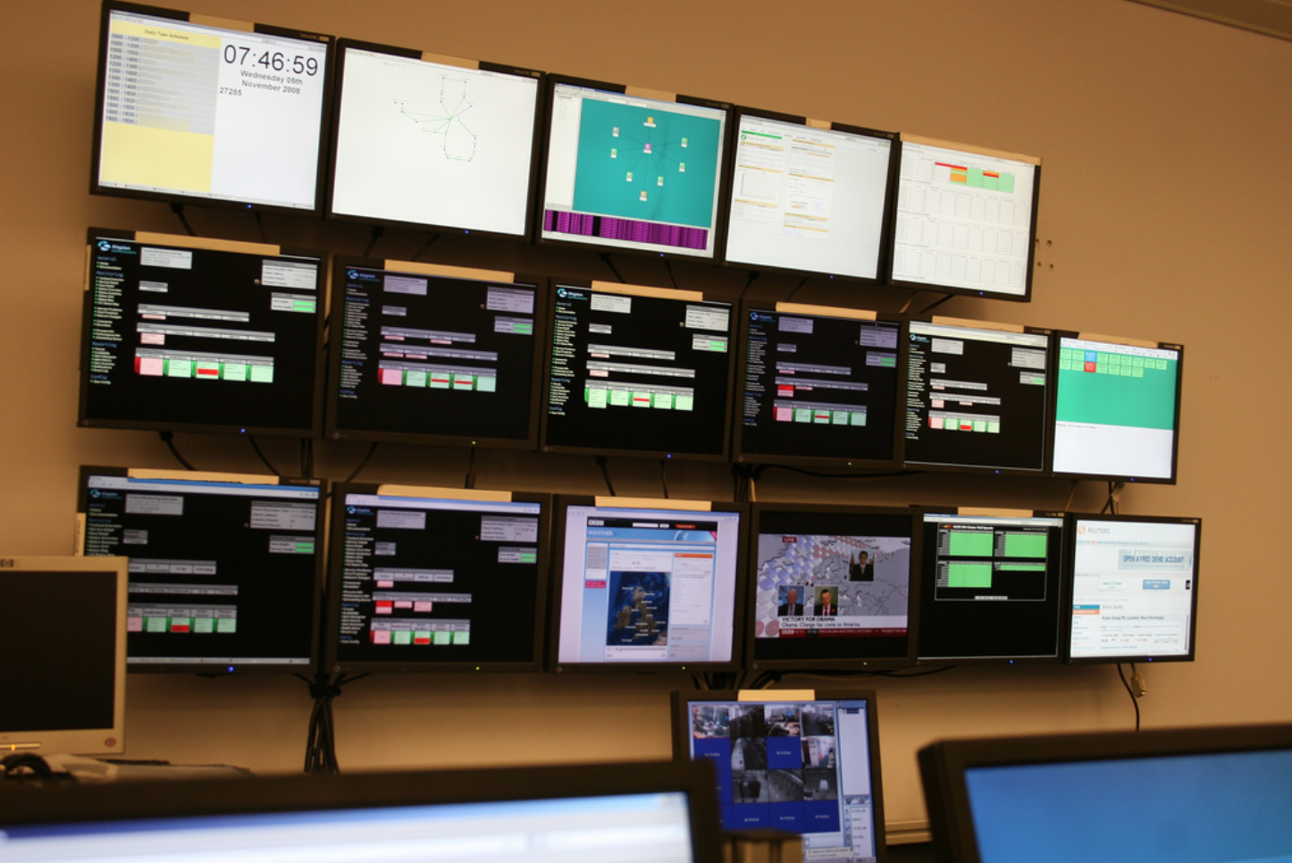
Network monitor & filter —— zhiyuan zhao Roy huang Hecheng Zhang

Slide 2
In this presentation
Introduction
What are Network Monitor and Filter
How does Our Monitor & Filter Works
Demo
Conclusion

Slide 3
What is Network monitoring & filter
-The network monitor provides a convenient way to see the information your application is sending and receiving on the network. This is helpful if you are debugging network interactions or looking for ways to optimize network traffic.
Filter like a firewall technique used to control network access by monitoring outgoing and incoming packets and allowing them to pass or halt based on the source and destination Internet Protocol (IP) addresses, protocols and ports.

Slide 4
HOW does OUR monitor & filter WORKS
Our project is a network monitor & filter, it can makes different operations based on config files from different users. the monitor will record the IP address and port number when they receive or send a pack. At the same time, the filter will control what will go into the blacklist and what can be passed. if there already has one in the blacklist, it will be dropped.
User space
filter
manage
pass
Blacklist
Whitelist

Slide 5
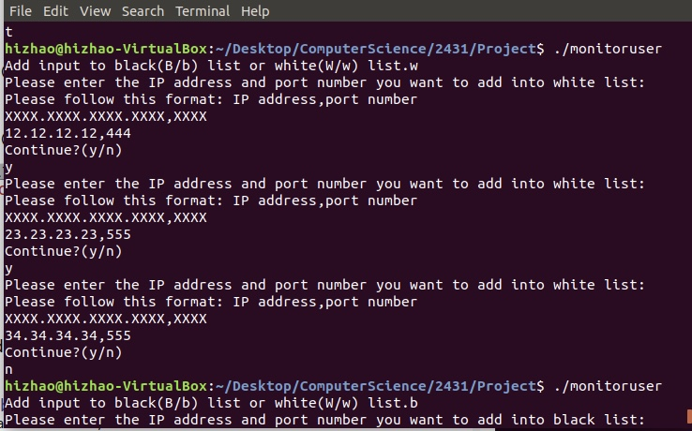
User space：
Black list
White list

Slide 6
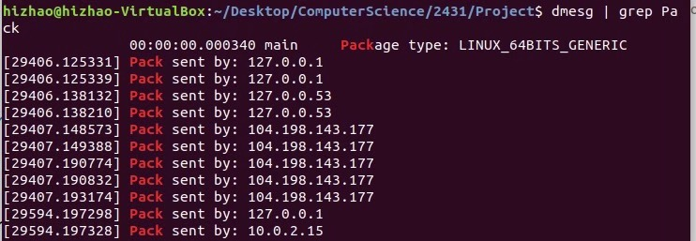
Monitor

Slide 7
Demo time

Slide 8

Thank you

